Slide 1
Python
TTT

Slide 2
Basic Command
a=1
a=1.68
a="hello“
a=[1,3,4,6]
print(a[2])
print("the array is : ", a)
name = input("Please enter your name : ")
print("Your name is ", name)
a = 1
while a < 5:
print(a)
a = a+1
a=3
if a==1:
print("a is 1")
elif a==2:
print("a is 2")
else:
print("a is not 1 or 2")

Slide 3
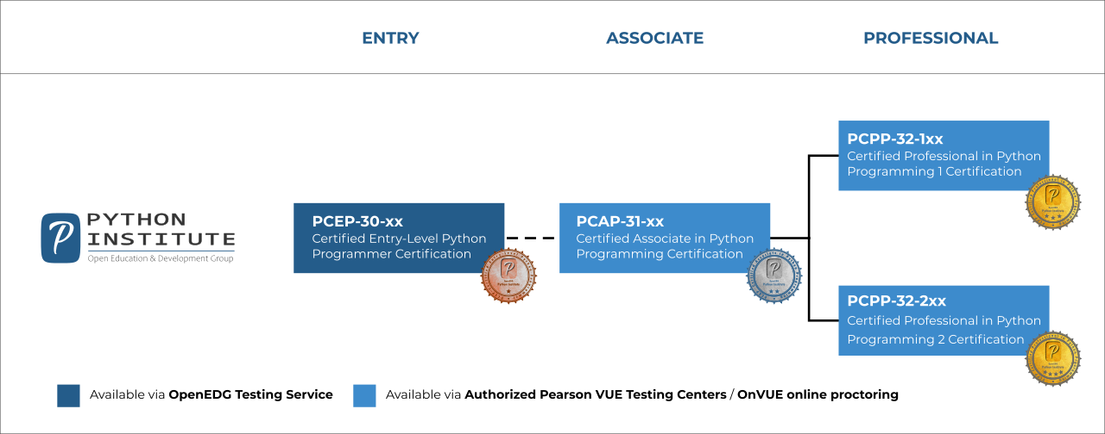
https://pythoninstitute.org/certification/

Slide 4

Finally - CEPP

Slide 5
Python
Basic Python – Variable, control flow, function
Data Structure – Array, list, dictionary, stack, queue
OOP – Class, subclass, instance, object, constructor, methods, private, static, abstract
SQL – CRUD
Network – Socket, REST API, json & json-server, XML, request, configuration file
Others – Decorator, Generator, Lamba, Exception, PIP, PYC, PyPI, Namespace, Virtual Environment, Multiple Variable, configuration, Multi-threading, Pipe, file, Magic, tktinker, Pickle & Shelve
AI – Regression and Decision Tree
Excel Using Python

Slide 6
Python
Day 1
Variable – Naming Convention, Assignment, Type (int, float, double, sequence: string, list, tuple), Operator (+ - / *)
control flow – If, elif, for, while
Day 2
Function
Data Structure – Array, list, dictionary, stack, queue
Advanced Python

Slide 7
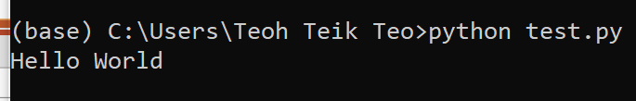
Ide (try print hello)
Anaconda https://www.anaconda.com/products/individual
Colab https://colab.research.google.com/

Slide 8
Basic

Slide 9
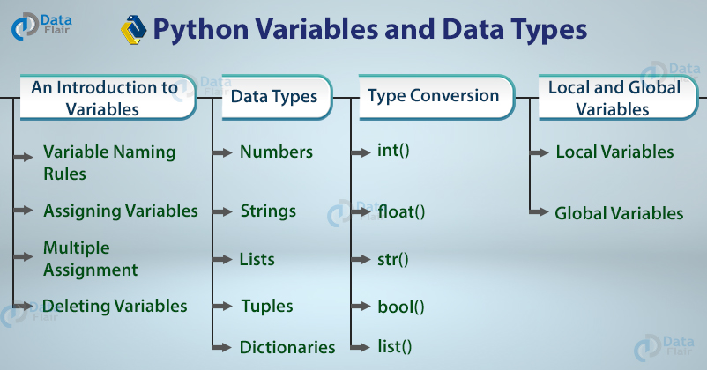
Variable Type

Slide 10
Basic Datatypes
Integers (default for numbers)
z = 5 / 2 # Answer 2, integer division
Floats
x = 3.456
Strings
Can use “” or ‘’ to specify with “abc” == ‘abc’

Slide 11
Always Try DIR() then Internet Help

Slide 12
Naming Rules
There are some reserved words:
and, assert, break, class, continue, def, del, elif, else, except, exec, finally, for, from, global, if, import, in, is, lambda, not, or, pass, print, raise, return, try, while
Dunder or magic methods in Python are the methods having two prefix and suffix underscores in the method name. Dunder here means “Double Under (Underscores)”. These are commonly used for operator overloading. Few examples for magic methods are: __init__, __add__, __len__, __repr__ etc.

Slide 13
Assignment
You can assign to multiple names at the same time
>>> x, y = 2, 3
>>> x
2
>>> y
3
This makes it easy to swap values
>>> x, y = y, x
Assignments can be chained
>>> a = b = x = 2

Slide 14
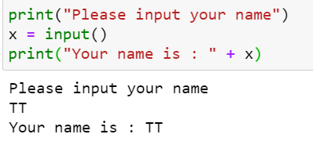
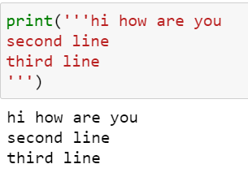
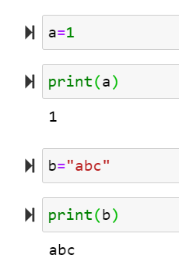
Python Simple Syntax (Variable, assign or input) Refer to textbook page …
print("hello")

Slide 15
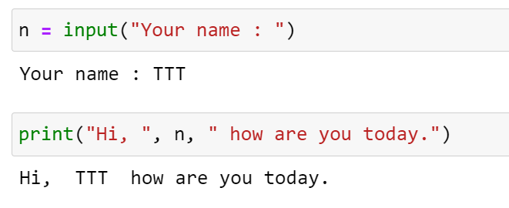
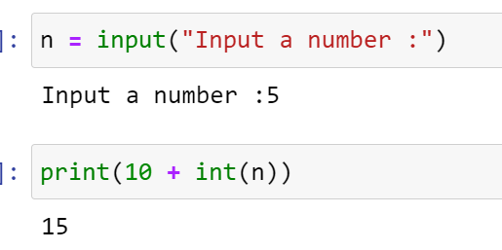
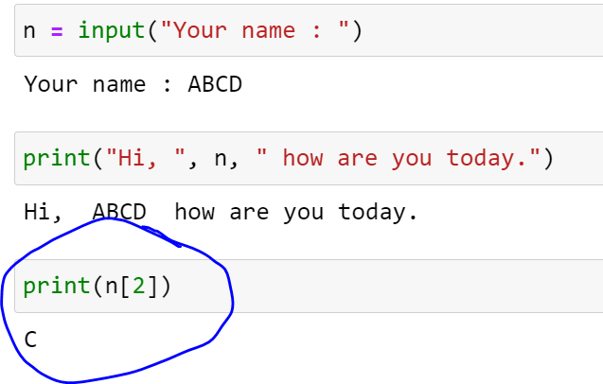
Input default is string

Slide 16
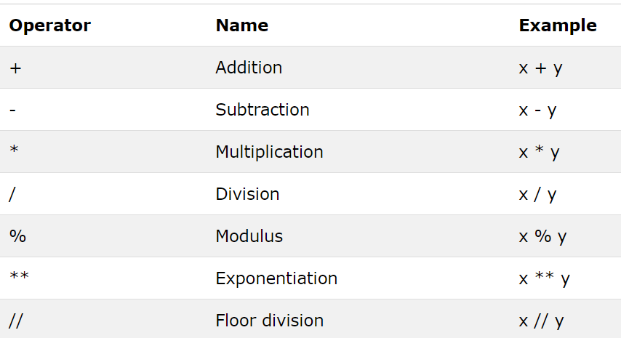
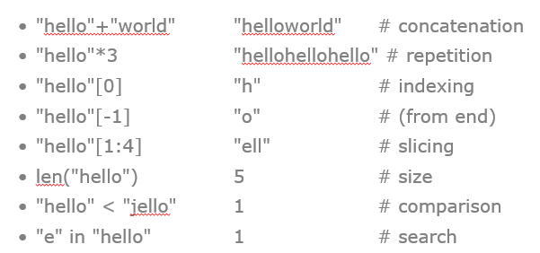
Operator : Number & String

Slide 17
Sequence Types
Tuple: (‘john’, 32)
A simple immutable ordered sequence of items
Items can be of mixed types, including collection types
Strings: “John Smith”
Immutable
Conceptually very much like a tuple
List: [1, 2, ‘john’]
Mutable ordered sequence of items of mixed types

Slide 18
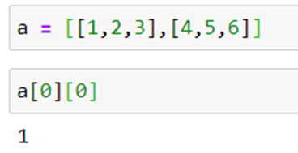
Sequence Types
Access individual members of a tuple, list, or string using square bracket “array” notation
Note that all are 0 based…
>>> tu = (23, ‘abc’, 4.56, (2,3), ‘def’)
>>> tu[1] # Second item in the tuple.
‘abc’
>>> li = [“abc”, 34, 4.34, 23]
>>> li[1] # Second item in the list.
34
>>> st = “Hello World”
>>> st[1] # Second character in string.
‘e’

Slide 19
Operations on Lists
>>> li = [5, 2, 6, 8]
>>> li.reverse() # reverse the list *in place*
>>> li
[8, 6, 2, 5]
>>> li.sort() # sort the list *in place*
>>> li
[2, 5, 6, 8]

Slide 20
Operations on Lists
Lists have many methods, including index, count, remove, reverse, sort
>>> li = [‘a’, ‘b’, ‘c’, ‘b’]
>>> li.index(‘b’) # index of 1st occurrence
1
>>> li.count(‘b’) # number of occurrences
2
>>> li.remove(‘b’) # remove 1st occurrence
>>> li
[‘a’, ‘c’, ‘b’]

Slide 21
Sequence Types
Define tuples using parentheses and commas
>>> tu = (23, ‘abc’, 4.56, (2,3), ‘def’)
Define lists are using square brackets and commas
>>> li = [“abc”, 34, 4.34, 23]
Define strings using quotes (“, ‘, or “““).
>>> st = “Hello World”
>>> st = ‘Hello World’
>>> st = “““This is a multi-line
string that uses triple quotes.”””

Slide 22
Positive and negative indices
>>> t = (23, ‘abc’, 4.56, (2,3), ‘def’)
Positive index: count from the left, starting with 0
>>> t[1]
‘abc’
Negative index: count from right, starting with –1
>>> t[-3]
4.56

Slide 23
Slicing: return copy of a subset
>>> t = (23, ‘abc’, 4.56, (2,3), ‘def’)
Return a copy of the container with a subset of the original members. Start copying at the first index, and stop copying before second.
>>> t[1:4]
(‘abc’, 4.56, (2,3))
Negative indices count from end
>>> t[1:-1]
(‘abc’, 4.56, (2,3))

Slide 24
Slicing: return copy of a =subset
>>> t = (23, ‘abc’, 4.56, (2,3), ‘def’)
Omit first index to make copy starting from beginning of the container
>>> t[:2]
(23, ‘abc’)
Omit second index to make copy starting at first index and going to end
>>> t[2:]
(4.56, (2,3), ‘def’)

Slide 25
The ‘in’ Operator
Boolean test whether a value is inside a container:
>>> t = [1, 2, 4, 5]
>>> 3 in t
False
>>> 4 in t
True
>>> 4 not in t
False
For strings, tests for substrings
>>> a = 'abcde'
>>> 'c' in a
True
>>> 'cd' in a
True
>>> 'ac' in a
False
Be careful: the in keyword is also used in the syntax of for loops and list comprehensions

Slide 26
The + Operator
The + operator produces a new tuple, list, or string whose value is the concatenation of its arguments.
>>> (1, 2, 3) + (4, 5, 6)
(1, 2, 3, 4, 5, 6)
>>> [1, 2, 3] + [4, 5, 6]
[1, 2, 3, 4, 5, 6]
>>> “Hello” + “ ” + “World”
‘Hello World’

Slide 27
The * Operator
The * operator produces a new tuple, list, or string that “repeats” the original content.
>>> (1, 2, 3) * 3
(1, 2, 3, 1, 2, 3, 1, 2, 3)
>>> [1, 2, 3] * 3
[1, 2, 3, 1, 2, 3, 1, 2, 3]
>>> “Hello” * 3
‘HelloHelloHello’

Slide 28
Operations on Lists Only
>>> li = [1, 11, 3, 4, 5]
>>> li.append(‘a’) # Note the method syntax
>>> li
[1, 11, 3, 4, 5, ‘a’]
>>> li.insert(2, ‘i’)
>>>li
[1, 11, ‘i’, 3, 4, 5, ‘a’]

Slide 29
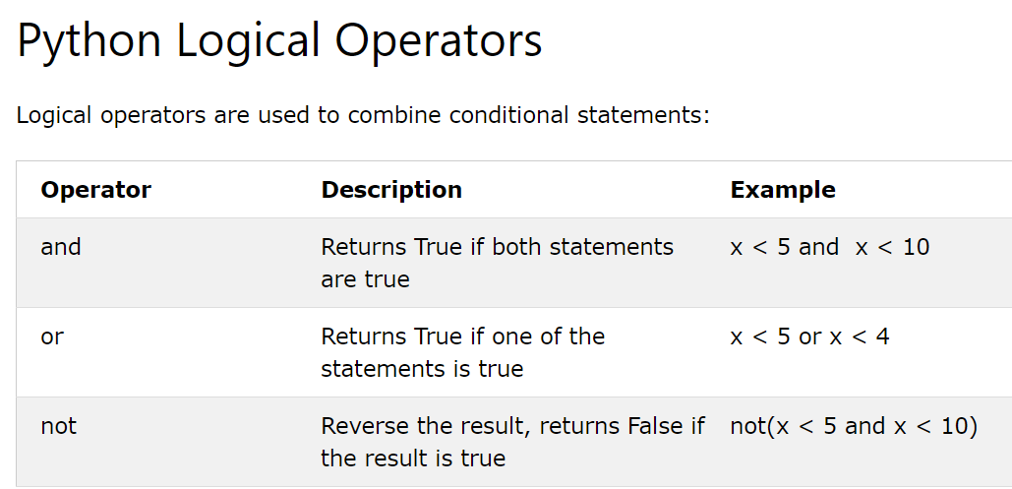
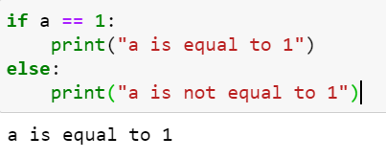
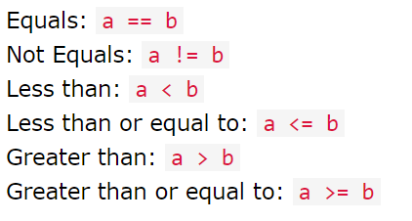
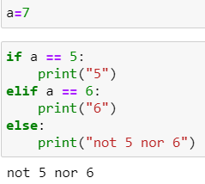
If else

Slide 30
And equivalent
if c == 5 and d ==6:
print("c is 5 and d is 6")
else:
print("c is not 5 or d is not 6")
if c == 5:
if d == 6:
print("c is 5 and d is 6")
else:
print("c is not 5 or d is not 6")
else:
print("c is not 5 or d is not 6")

Slide 31
Or Equivalent
if x==4 or y==5:
print("x is 4 or y is 5")
else:
print("x is not 4 and y is not 5")
if x==4:
print("x is 4 or y is 5")
elif y==5:
print("x is 4 or y is 5")
else:
print("x is not 4 and y is not 5")

Slide 32
A Code Sample (in IDLE)
x = 34 - 23 # A comment.
y = "Hello" # Another one.
z = 3.45
if z == 3.45 or y == "Hello":
x = x + 1
y = y + "World" # String concat.
print(x)
print(y)
Logical operators are words (and, or, not) not symbols

Slide 33
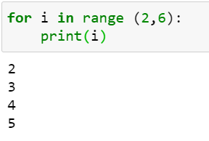
For Loop
i = 1
while i <10:
print(i)
i = i+1
i = 1
while 1==1:
print(i)
i = i+1
if i == 10:
break

Slide 34
While loop
a = 0
while a != 10:
a = a+1
print(a)
a = 0
while a != 10:
if a == 9:
break
print(a)
a = a+1
for i in range(1,10):
print(i)

Slide 35
File – read write and append
f = open(filename[, mode[, buffersize])
mode can be "r", "w", "a" (like C stdio); default "r"
append "b" for text translation mode
append "+" for read/write open
buffersize: 0=unbuffered; 1=line-buffered; buffered
methods:
read([nbytes]), readline(), readlines()
write(string), writelines(list)
seek(pos[, how]), tell()
flush(), close()
fileno()
f = open("C:/Users/Teoh Teik Teo/OneDrive - TSS Global Pte. Ltd/TT Library/AI Model/Python/Test.txt")
s = f.read()
f.close()
print(s)
f = open("C:/Users/Teoh Teik Teo/OneDrive - TSS Global Pte. Ltd/TT Library/AI Model/Python/Test.txt", "a")
f.writelines(“\nHi Python")
f.close()
f = open("C:/Users/Teoh Teik Teo/OneDrive - TSS Global Pte. Ltd/TT Library/AI Model/Python/Test.txt", "w")
f.writelines("Hi Python")
f.close()

Slide 36
Simple task
Write a Python program which accepts the radius of a circle from the user and compute the area.

Slide 37
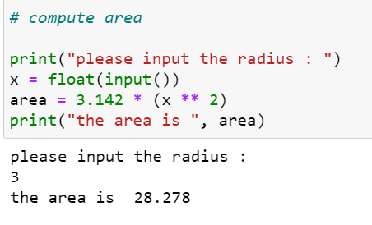
Simple task Solution
Write a Python program which accepts the radius of a circle from the user and compute the area.

Slide 38
Creating a function
def first():
print("My first function")
first()

Slide 39
Creating function with argument
def second(a,b):
print(a+b)
second(5,10)
def second(a,b):
print(a/b)
second(a=5,b=10)

Slide 40
Return the value in functio
def division(a,b):
return(a/b)
d = division(10,2)
print(d)

Slide 41
2 simple function
Given radius, calculate area, perimeter
cal_area(radius)
cal_perimeter(radius)

Slide 42
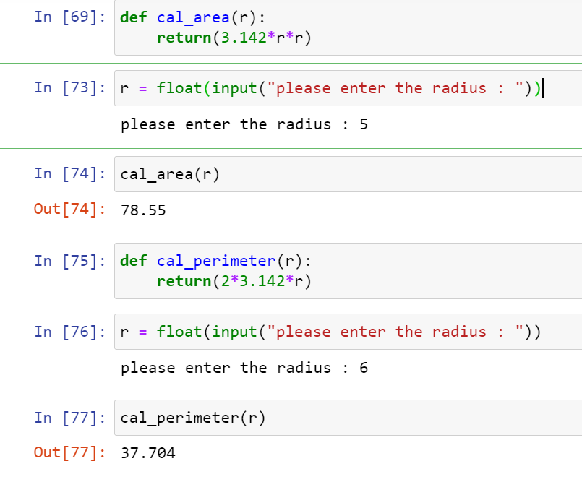

Slide 43
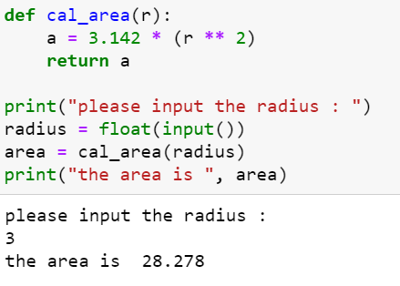
Creating a function

Slide 44
OOP

Slide 45
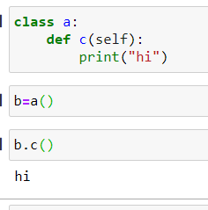
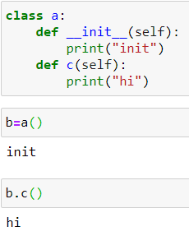
Class and OOP & __init__

Slide 46
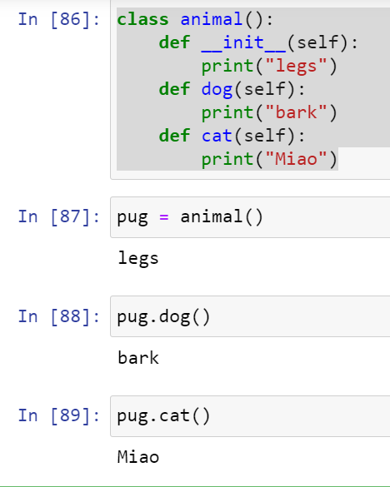

Slide 47
Object
Create 1 Object with 2 function, with __init__ as welcome notes
cal.area()
cal.perimeter()

Slide 48
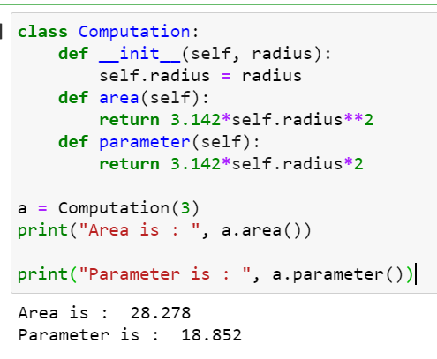
Object Oriented Programming: Creating a class
Write a Python Class which accepts the radius of a circle from the user and compute the area and parameter.
class Computation:
def __init__(self, radius):
self.radius = radius
def area(self):
return 3.142*self.radius**2
def parameter(self):
return 3.142*self.radius*2
a = Computation(3)
print("Area is : ", a.area())
print("Parameter is : ", a.parameter())

Slide 49
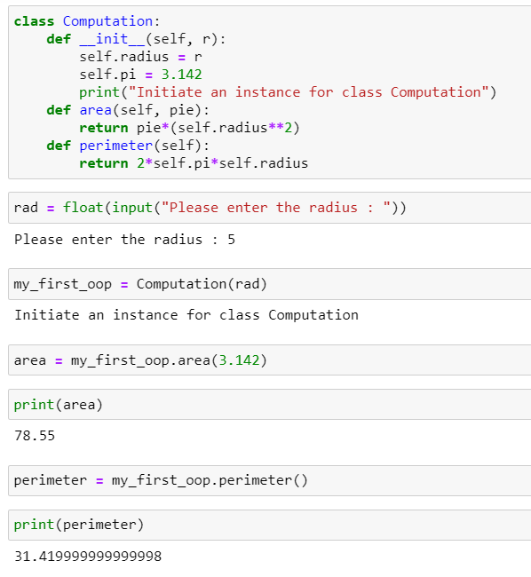

Slide 50
Graph
j = [1,2,3,4,5]
r = [6,7,8,9,10]
import matplotlib.pyplot as plt
plt.plot(j, r)
plt.xlabel('parameter')
plt.ylabel('rmse')
plt.title('rmse')
plt.show()

Slide 51
Question
Create a program that asks the user to enter their name and their age. Print out a message addressed to them that tells them the year that they will turn 100 years old.

Slide 52
Solution
name = input("What is your name: ")
age = int(input("How old are you: "))
year = str((2014 - age)+100)
print(name + " will be 100 years old in the year " + year)

Slide 53
Question
Ask the user for a number. Depending on whether the number is even or odd, print out an appropriate message to the user.

Slide 54
Solution
num = input("Enter a number: ")
mod = num % 2
if mod > 0:
print("You picked an odd number.")
else:
print("You picked an even number.")

Slide 55
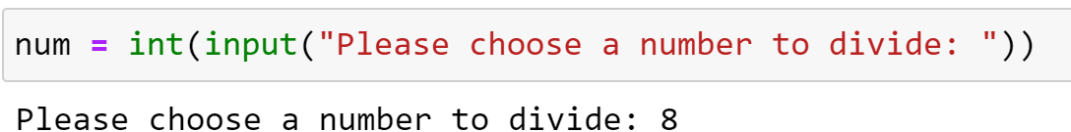
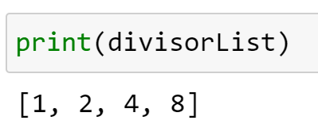
Question
Create a program that asks the user for a number and then prints out a list of all the divisors of that number. (If you don’t know what a divisor is, it is a number that divides evenly into another number. For example, 13 is a divisor of 26 because 26 / 13 has no remainder.)

Slide 56
Answer
num = int(input("Please choose a number to divide: "))
listRange = list(range(1,num+1))
divisorList = []
for number in listRange:
if num % number == 0:
divisorList.append(number)
print(divisorList)

Slide 57
Palindromes
The word “dad” and the number “1881” are palindromes.

Slide 58
Question
wrd=input("Please enter a word")
wrd=str(wrd)
rvs=wrd[::-1]
print(rvs)
if wrd == rvs:
print("This word is a palindrome")
else:
print("This word is not a palindrome")
What does :: -1 mean in Python?
It means, "start at the end; count down to the beginning, stepping backwards one step at a time.“
::2 means count forward 2 => abcde -> ace
Wrd = 1234567890
wrd[0:3:1] = 123
Try…..

Slide 59
Question
Let’s say I give you a list saved in a variable: a = [1, 4, 9, 16, 25, 36, 49, 64, 81, 100]. Take this list a and makes a new list that has only the even elements of this list in it.

Slide 60
Answer
a = [1, 4, 9, 16, 25, 36, 49, 64, 81, 100]
b=[]
for i in a:
if i % 2 == 0:
b.append(i)
print(b)
a = [1, 4, 9, 16, 25, 36, 49, 64, 81, 100]
b = [number for number in a if number % 2 == 0]
print(b)

Slide 61
Question
Make a two-player Rock-Paper-Scissors game. (Hint: Ask for player plays (using input), compare them, print out a message of congratulations to the winner, and ask if the players want to start a new game)

Slide 62
Answer
import sys
user1 = input("What's your name?")
user2 = input("And your name?")
user1_answer = input("%s, do yo want to choose rock, paper or scissors?" % user1)
user2_answer = input("%s, do you want to choose rock, paper or scissors?" % user2)
def compare(u1, u2):
if u1 == u2:
return("It's a tie!")
elif u1 == 'rock':
if u2 == 'scissors':
return("Rock wins!")
else:
return("Paper wins!")
elif u1 == 'scissors':
if u2 == 'paper':
return("Scissors win!")
else:
return("Rock wins!")
elif u1 == 'paper':
if u2 == 'rock':
return("Paper wins!")
else:
return("Scissors win!")
else:
return("Invalid input! You have not entered rock, paper or scissors, try again.")
sys.exit()
print(compare(user1_answer, user2_answer))

Slide 63
Question
Generate a random number between 1 and 9 (including 1 and 9). Ask the user to guess the number, then tell them whether they guessed too low, too high, or exactly right.

Slide 64
Answer
import random
rd = random.randint(1,9)
guess = 0
c = 0
while guess != rd:
guess = input("Enter a guess between 1 to 9")
guess = int(guess)
c += 1
if guess < rd:
print("Too low")
elif guess > rd:
print("Too high")
else:
print("Right!")
print("You took only", c, "tries!")
print(rd)

Slide 65
Question
Ask the user for a number and determine whether the number is prime or not. (For those who have forgotten, a prime number is a number that has no divisors.).

Slide 66
Solution
n = input("enter ")
n = int(n)
flag = 0
for i in range(2,n-1):
if n%i == 0:
flag = 1
if flag == 0:
print("This is a prime number")
elif flag == 1:
print("This is not a prime number")

Slide 67
Question
Write a program that asks the user how many Fibonacci numbers to generate and then generates them. Take this opportunity to think about how you can use functions. Make sure to ask the user to enter the number of numbers in the sequence to generate.(Hint: The Fibonacci seqence is a sequence of numbers where the next number in the sequence is the sum of the previous two numbers in the sequence. The sequence looks like this: 1, 1, 2, 3, 5, 8, 13, …)

Slide 68
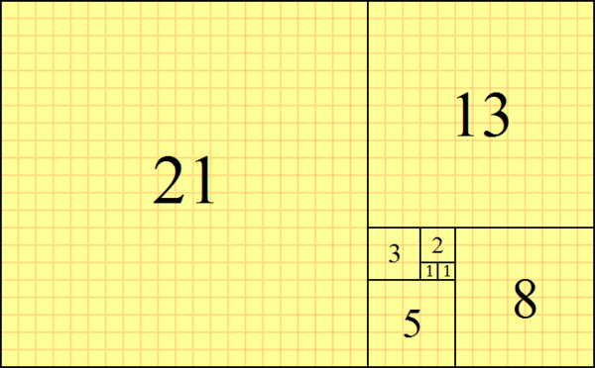

Solution
f=[1,1]
n = input("please enter number : ")
n = int(n)
for i in range(0,n-2):
f.append(f[i]+f[i+1])
print(f)

Slide 69
Question
Write a password (length of 8) generator in Python. The passwords should be random, generating a new password every time the user asks for a new password.
s = "abcdefghijklmnopqrstuvwxyz01234567890ABCDEFGHIJKLMNOPQRSTUVWXYZ!@#$%^&*()?"

Slide 70
Solution
import random
s = "abcdefghijklmnopqrstuvwxyz01234567890ABCDEFGHIJKLMNOPQRSTUVWXYZ!@#$%^&*()?"
"".join(random.sample(s,8))

Slide 71
Question
Take the code from the How To Extract data from website.

Slide 72
Solution
import requests
from bs4 import BeautifulSoup
base_url = 'http://www.nytimes.com'
r = requests.get(base_url)
soup = BeautifulSoup(r.text)
print(soup)

Slide 73
Optional

Slide 74
Question
Create a program that will play the “cows and bulls” game with the user. The game works like this:
Randomly generate a 4-digit number. Ask the user to guess a 4-digit number. For every digit that the
user guessed correctly in the correct place, they have a “cow”. For every digit the user guessed
correctly in the wrong place is a “bull.” Every time the user makes a guess, tell them how many
“cows” and “bulls” they have. Once the user guesses the correct number, the game is over. Keep track
of the number of guesses the user makes throughout teh game and tell the user at the end.
Say the number generated by the computer is 1038. An example interaction could look like this:
Welcome to the Cows and Bulls Game!
Enter a number:
>>> 1234
2 cows, 0 bulls
>>> 1256
1 cow, 1 bull

Slide 75
Solution
import random
def compare_numbers(number, user_guess):
cowbull = [0,0] #cows, then bulls
for i in range(len(number)):
if number[i] == user_guess[i]:
cowbull[1]+=1
else:
cowbull[0]+=1
return cowbull
if __name__=="__main__":
playing = True #gotta play the game
number = str(random.randint(0,9999)) #random 4 digit number
guesses = 0
print("Let's play a game of Cowbull!") #explanation
print("I will generate a number, and you have to guess the numbers one digit at a time.")
print("For every number in the wrong place, you get a cow. For every one in the right place, you get a bull.")
print("The game ends when you get 4 bulls!")
print("Type exit at any prompt to exit.")
while playing:
user_guess = input("Give me your best guess!")
if user_guess == "exit":
break
cowbullcount = compare_numbers(number,user_guess)
guesses+=1
print("You have "+ str(cowbullcount[0]) + " cows, and " + str(cowbullcount[1]) + " bulls.")
if cowbullcount[1]==4:
playing = False
print("You win the game after " + str(guesses) + "! The number was "+str(number))
break #redundant exit
else:
print("Your guess isn't quite right, try again.")

Slide 76
Others
https://www.practicepython.org/

Slide 77
Advance Python

Slide 78
Data Structure

Slide 79
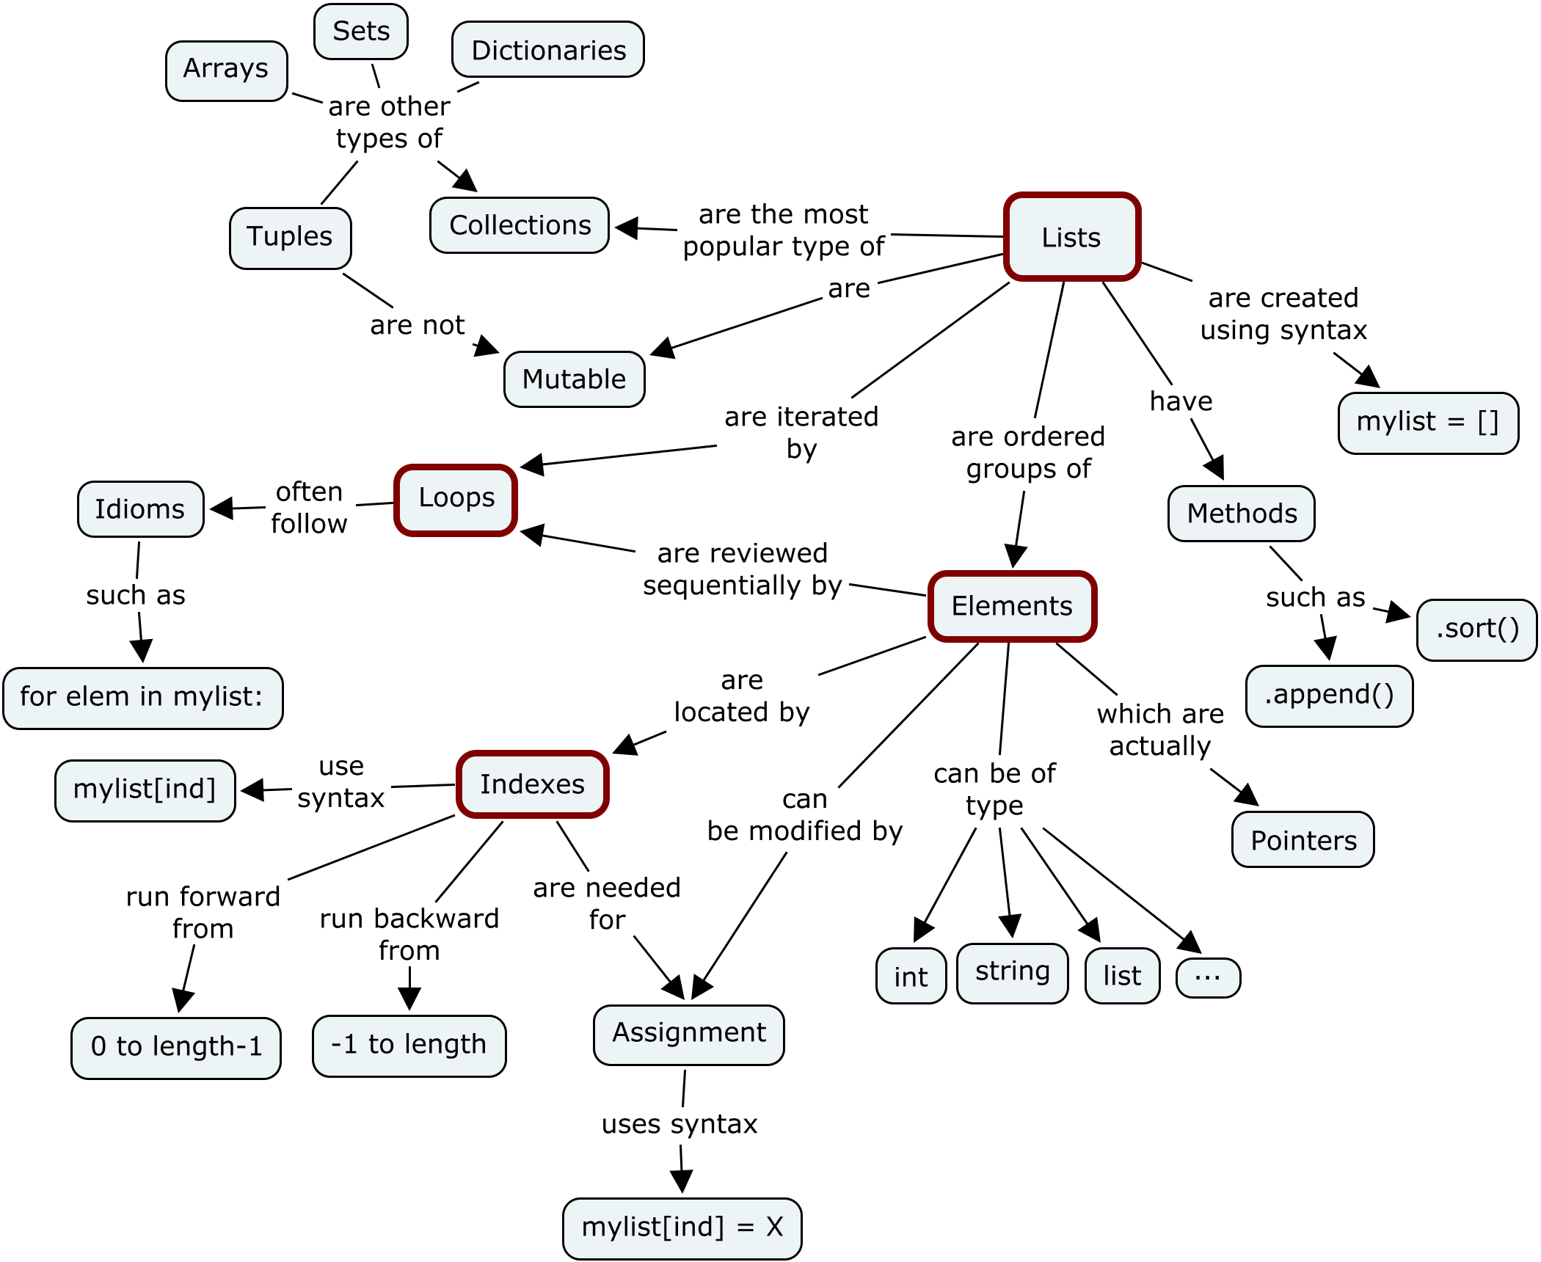
Mutable & Unmutable

Slide 80
Python Data Structure
Dictionaries, Maps, and Hash Tables
Array
Sets
Stacks (LIFOs)
Queues (FIFOs)

Slide 81
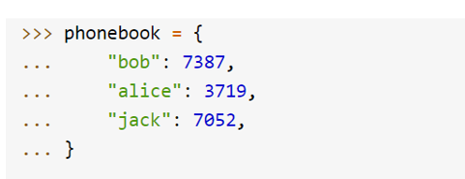
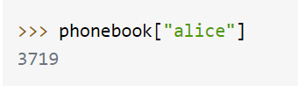
Dictionary

Slide 82
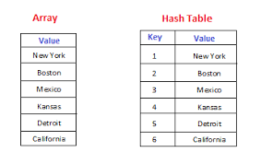
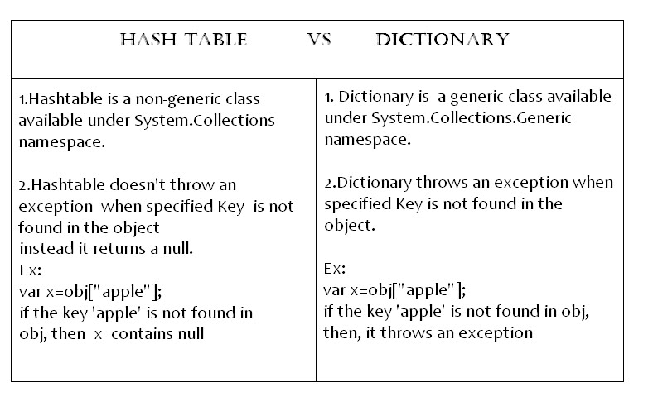
Dictionary Operator
Hash tables, "associative arrays"
d = {"duck": "eend", "water": "water"}
Lookup:
d["duck"] -> "eend"
d["back"] # raises KeyError exception
Delete, insert, overwrite:
del d["water"] # {"duck": "eend", "back": "rug"}
d["back"] = "rug" # {"duck": "eend", "back": "rug"}
d["duck"] = "duik" # {"duck": "duik", "back": "rug"}
Keys, values, items:
d.keys() -> ["duck", "back"]
d.values() -> ["duik", "rug"]
d.items() -> [("duck","duik"), ("back","rug")]
Presence check:
d.has_key("duck") -> 1; d.has_key("spam") -> 0

Slide 83
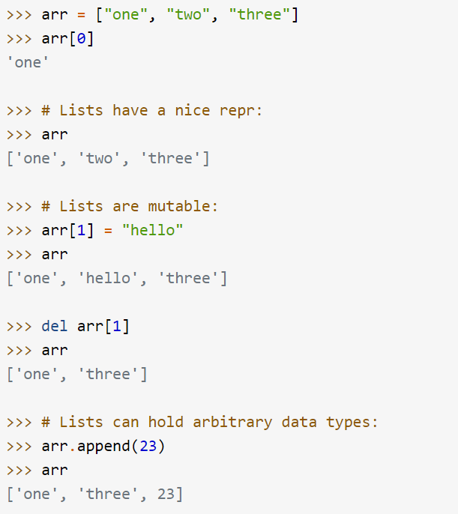
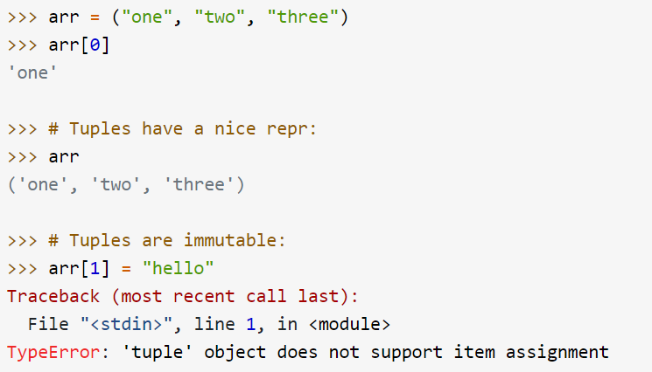
Array
Types of Array
List (Mutable)
Tuple (Immutable)

Slide 84
Operator for lists
Flexible arrays, not Lisp-like linked lists
a = [98, "bottles of beer", ["on", "the", "wall"]]
Item and slice assignment
a[0] = 98
a[1:2] = ["bottles", "of", "beer"] -> [98, "bottles", "of", "beer", ["on", "the", "wall"]]
del a[-1] -> [98, "bottles", "of", "beer"]
>>> a = range(5) # [0,1,2,3,4]
>>> a.append(5) # [0,1,2,3,4,5]
>>> a.insert(0, 42) # [42,0,1,2,3,4]
>>> a.reverse() # [4,3,2,1,0]
>>> a.sort() # [0,1,2,3,4]

Slide 85
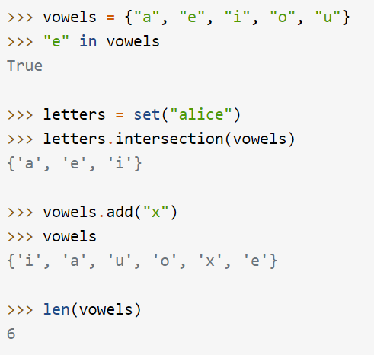
Sets
Sets are used to store multiple items in a single variable.
Set is one of 4 built-in data types in Python used to store collections of data, the other 3 are List, Tuple, and Dictionary, all with different qualities and usage.
A set is a collection which is both unordered and unindexed.
Sets are written with curly brackets.

Slide 86
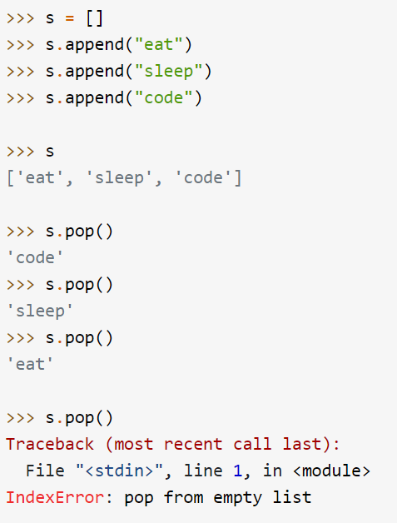
Stack (LIFO)

Slide 87
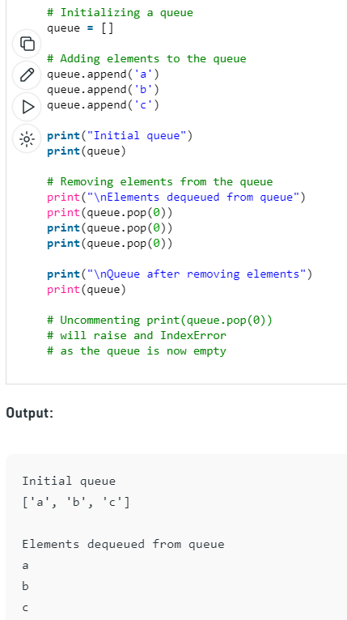
Queue (FIFO)

Slide 88
OOP

Slide 89
Class and OOP & __init__

Slide 90
Object Oriented Programming: Creating a class
Write a Python Class which accepts the radius of a circle from the user and compute the area and parameter.
class Computation:
def __init__(self, radius):
self.radius = radius
def area(self):
return 3.142*self.radius**2
def parameter(self):
return 3.142*self.radius*2
a = Computation(3)
print("Area is : ", a.area())
print("Parameter is : ", a.parameter())

Slide 91
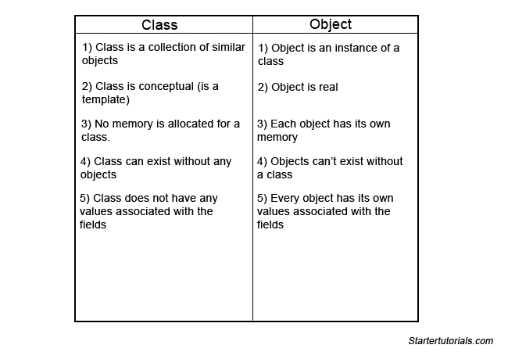
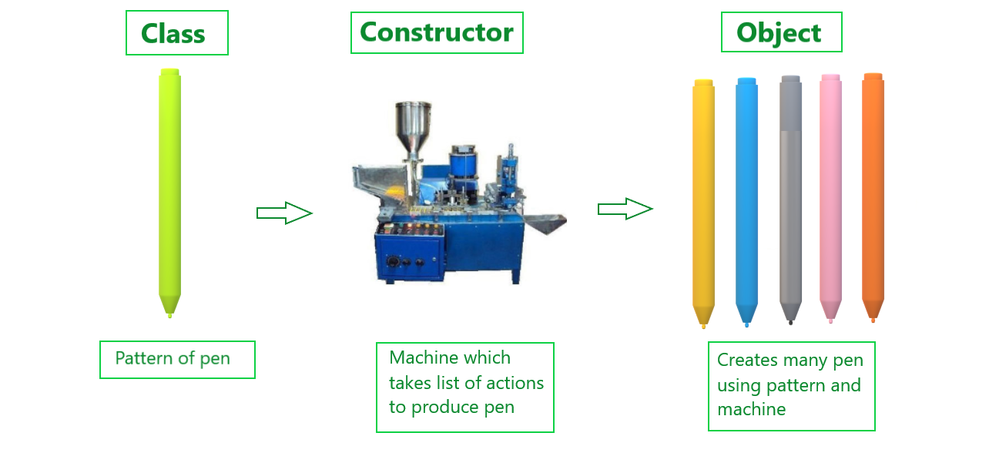
Class, Object (Instance), Constructor

Slide 92
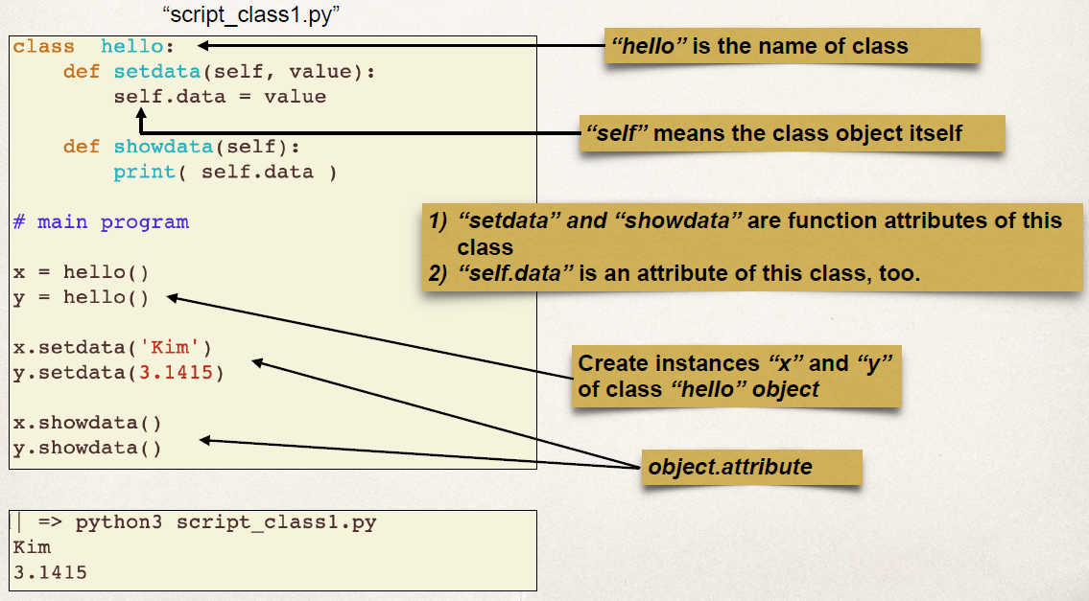
Class, Object, Instance

Slide 93
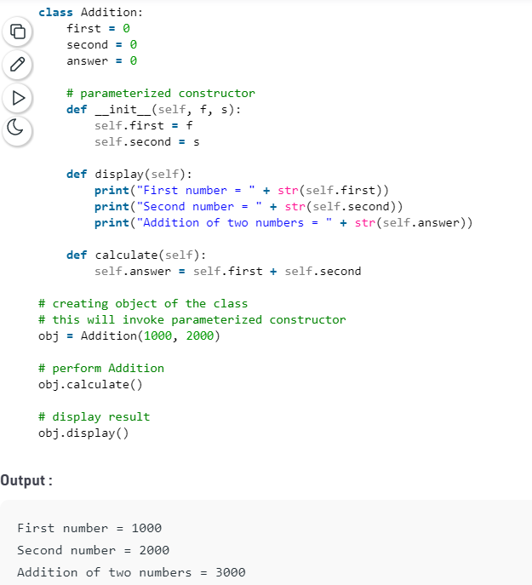
Constructor in Python Code

Slide 94
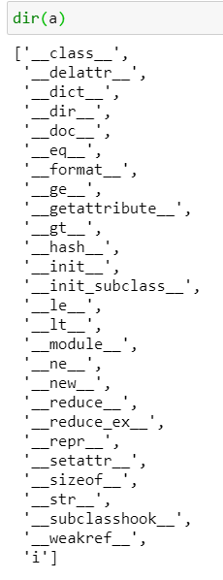
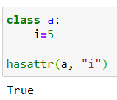
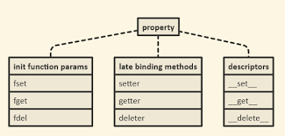
Property – hasattr() to check

Slide 95
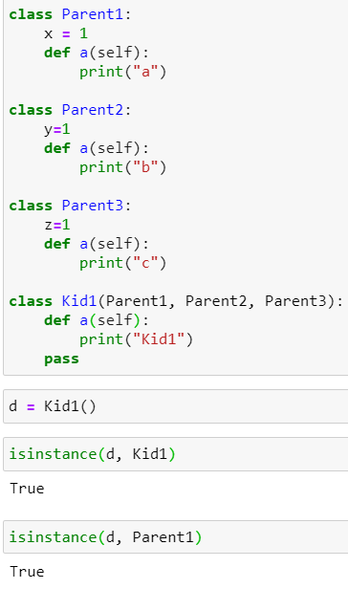
isinstance

Slide 96
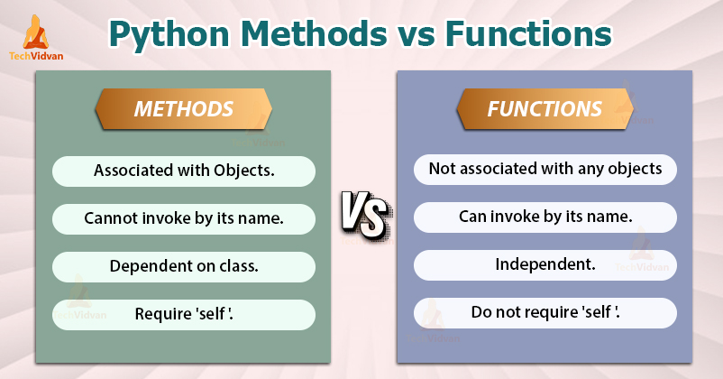
Methods vs Function
https://techvidvan.com/tutorials/python-methods-vs-functions/

Slide 97
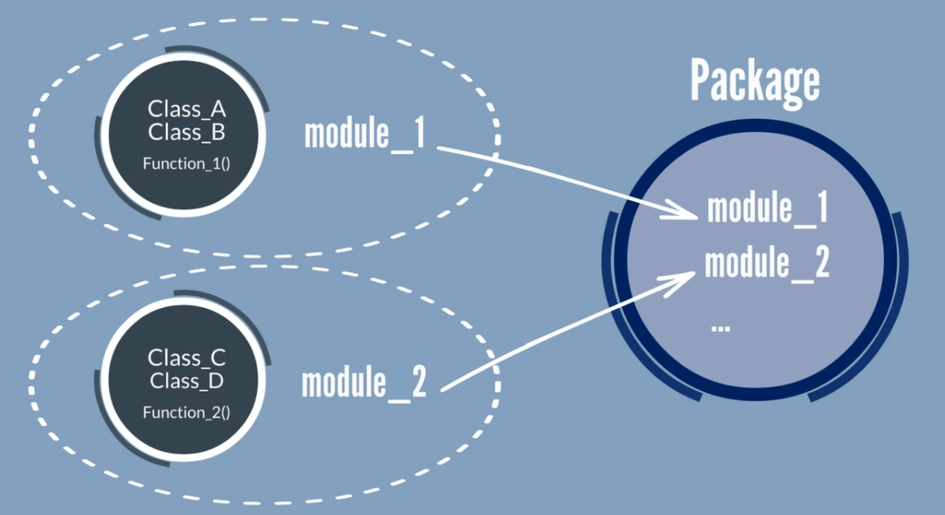
Package vs Module vs Class vs Method

Slide 98
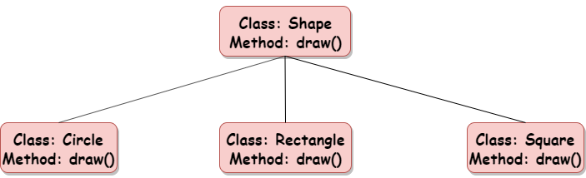
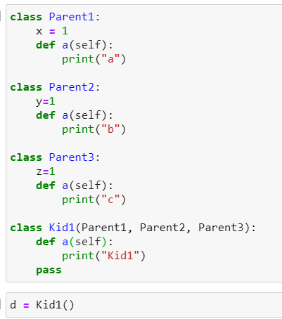

Subclass, Polymorphism & inheritance
Polymorphism lets us define methods in the child class that have the same name as the methods in the parent class. In inheritance, the child class inherits the methods from the parent class

Slide 99


Polymorphism & inheritance

Slide 100

Composition (has, use abc) vs Inheritance (belong to)

Slide 101

Private vs Protected vs Public

Slide 102

Private vs Protected vs Public

Slide 103

Public, Protected, Private

Slide 104


Encapsulation: How to access private variable. __object or setter and getter

Slide 105


Multiple Superclass Attribute

Slide 106


MRO — Method Resolution Order

Slide 107


Multiple Superclass Methods – Same name then depends on mro (Method Resolution Order)

Slide 108

Passing class as argument

Slide 109

__class__

Slide 110

__dict__

Slide 111


Super()

Slide 112

Polymorphism
In Python, polymorphism is the provision of a single interface to objects of different types. In other words, it is the ability to create abstract methods from specific types in order to treat those types in a uniform way.

Slide 113

dir() module in a object

Slide 114

Static vs class methods
# Python program to demonstrate
# use of class method and static method.
from datetime import date
class Person:
def __init__(self, name, age):
self.name = name
self.age = age
# a class method to create a Person object by birth year.
@classmethod
def fromBirthYear(cls, name, year):
return cls(name, date.today().year - year)
# a static method to check if a Person is adult or not.
@staticmethod
def isAdult(age):
return age > 18
person1 = Person('mayank', 21)
person2 = Person.fromBirthYear('mayank', 1996)
print (person1.age)
print (person2.age)
# print the result
Person.isAdult(22)
static method can be called without an object for that class.

Slide 115

Static vs class

Slide 116


Abstract base class (Interface)
By defining an abstract base class, you can define a common Application Program Interface(API) for a set of subclasses.
Triangle is composed of polygon.

Slide 117

Overloading and Overriding

Slide 118

Interface vs Abstract

Slide 119
SQL & XML

Slide 120


Create DB, Table, Insert, Select
import sqlite3
c = sqlite3.connect("First.db")
c.execute('''CREATE TABLE tasks (
id INT PRIMARY KEY,
name TEXT
);''')
This must be single code

Slide 121


Slide 122

Multiple SQL

Slide 123



Select statement (where condition)

Slide 124

Update

Slide 125

delete

Slide 126



xml
<?xml version="1.0"?>
<data>
<book title = "Hi">
<author>TT</author>
<year>1968</year>
</book>
<book title = "Hi2">
<author>TT2</author>
<year>1978</year>
</book>
</data>
import xml.etree.ElementTree as ET
t = ET.parse("C:/Users/User/OneDrive - TSS Global Pte. Ltd/TT Library/AI Model/Python/book.xml")

Slide 127

Xml elements : Select (tag, child, text)

Slide 128

Find and get

Slide 129

Root, child, sub child

Slide 130

remove

Slide 131

Set (updates)

Slide 132

write

Slide 133
Network Programming

Slide 134

Network Programming: REST API using Request & json

Slide 135


Json & xml format

Slide 136

Request HTTP method

Slide 137


request

Slide 138

Cars.json

Slide 139

Request for specific information

Slide 140



Socket Programming

Slide 141

Socket Programming
sock.send(b"GET / HTTP/1.1\r\nHost: www.google.com \r\nConnection: close\r\n\r\n")

Slide 142

Socket – Server Client
import socket
HOST = '127.0.0.1'
PORT = 9999
with socket.socket() as s:
s.bind((HOST, PORT))
s.listen()
conn, addr = s.accept()
with conn:
print('Connected by', addr)
while True:
data = conn.recv(1024)
if not data:
break
conn.sendall(data)
import socket
HOST = '127.0.0.1'
PORT = 9999
with socket.socket() as s:
s.connect((HOST, PORT))
s.sendall(b'Hello, world')
data = s.recv(1024)
print('Received', repr(data))

Slide 143


Configuration File

Slide 144
Others

Slide 145

pipe

Slide 146


Pickle & Shelve (store variable in file)

Slide 147


Decorator

Slide 148
Decorator
def make_bold(fn):
return lambda : "<b>" + fn() + "</b>"
def make_italic(fn):
return lambda : "<i>" + fn() + "</i>"
@make_bold
@make_italic
def hello():
return "hello world"
helloHTML = hello()

Slide 149

Generator & Yield (multiple return function)

Slide 150

Pass multiple argument *args and **kwargs
def adder(*num):
sum = 0
for n in num:
sum = sum + n
print("Sum:",sum)
adder(3,5)
adder(4,5,6,7)
adder(1,2,3,5,6)

Slide 151
Pass Multiple Argument
def intro(**data):
print("Data type of argument:",type(data))
for key, value in data.items():
print("{} is {}".format(key,value))
intro(Firstname="Sita", Lastname="Sharma", Age=22, Phone=1234567890)
intro(Firstname="John", Lastname="Wood", Email="johnwood@nomail.com", Country="Wakanda", Age=25, Phone=9876543210)

Slide 152


Except & Raise Exception

Slide 153






Types of exception & Raise
https://docs.python.org/3/library/exceptions.html
https://docs.python.org/3/library/exceptions.html

Slide 154

Assertion

Slide 155

Lambda vs function

Slide 156

__name__ is the name of a module

Slide 157

pip https://pip.pypa.io/en/stable/cli/

Slide 158

Pypi https://pypi.org/search/?c=Programming+Language+%3A%3A+Python+%3A%3A+3
Including

Slide 159

Pyc file
pyc files are created by the Python interpreter when a . py file is imported. They contain the "compiled bytecode" of the imported module/program so that the "translation" from source code to bytecode (which only needs to be done once) can be skipped on subsequent imports if the . pyc is newer than the corresponding .

Slide 160


Name space

Slide 161


Buildin Namespace

Slide 162




Platform : Enquiry on the system

Slide 163


Predefine Function

Slide 164

Create Virtual Environment
python -m venv project_env

Slide 165

Activate the Environment
project_env\Scripts\activate.bat

Slide 166

Pip list (nothing inside)

Slide 167

Try install one packages (say numpy)

Slide 168

Magic method
https://www.tutorialsteacher.com/python/magic-methods-in-python

Slide 169


Log
Logging is a means of tracking events that happen when some software runs. The software’s developer adds logging calls to their code to indicate that certain events have occurred.
fh = logging.FileHandler('spam4.log')
logger.addHandler(fh)
logger.debug('This message should go to the log file')
logger.warning('And this, too')

Slide 170

Log

Slide 171

Multi-Threading
import threading
from random import randint
from time import sleep
def print_number(number):
# Sleeps a random 1 to 10 seconds
rand_int_var = randint(1, 10)
sleep(rand_int_var)
print("Thread " + str(number) + " slept for " + str(rand_int_var) +"\n")
thread_list = []
for i in range(1, 10):
t = threading.Thread(target=print_number, args=(i,))
# Sticks the thread in a list so that it remains accessible
thread_list.append(t)
# Starts threads
for thread in thread_list:
thread.start()
print("Done")

Slide 172

Window GUI - tkinter
from tkinter import *
window = Tk()
window.title("Welcome to tkinter")
Label(window, text="hello").grid(column=1,row=1)
window.mainloop()

Slide 173

PEP Python Enhancement Proposals

Slide 174

PEP8 Style

Slide 175



Shallow and Deep Copy

Slide 176
INI file
default_path = "/path/name/"
default_file = "file.txt"
[DEFAULT]
ServerAliveInterval = 45
Compression = yes
CompressionLevel = 9
ForwardX11 = yes
[bitbucket.org]
User = hg
[topsecret.server.com]
Port = 50022
ForwardX11 = no
# Read file and and create if it not exists
config = iniFile( 'FILE.INI' )
# Get "default_path"
config.default_path
# Print (string)/path/name
print config.default_path
# Create or Update
config.append( 'default_path', 'var/shared/' )
config.append( 'default_message', 'Hey! help me!!' )

Slide 177
AI & Data Wrangling

Slide 178
Library
Pandas
numpy
scipy
sklearn

Slide 179
import pandas as pd
df = pd.read_csv("C:/Users/User/OneDrive - TSS Global Pte. Ltd/TT Library/AI Model/Data/LoanDefault Unclean.csv")
print(df)
#select column
df = df.loc[:, ["default", "student", "balance", "income"]]
print(df)
#remove na
df=df.dropna()
print(df)
#replace with number
df['default'] = df["default"].replace(("Yes", "No"), (0,1))
df['student'] = df["student"].replace(("Yes", "No"), (0,1))
print(df)
#remove not a number
for i in df.columns:
df=df[pd.to_numeric(df[i], errors='coerce').notnull()] #make it to null then remove null
print(df)

Slide 180
#remove outlier, before that, check the range first
df.describe()
#remove outlier
import numpy as np
from scipy import stats
z = stats.zscore(df.astype(np.float))
abs_z = np.abs(z)
filtered = (abs_z < 8).all(axis=1)
df = df[filtered]
import matplotlib.pyplot as plt
df.hist()
plt.show()
df.corr()
import seaborn as sns
sns.heatmap(df.corr())

Slide 181
X = df.loc[:,["student", "balance", "income"]]
Y = df.loc[:, ["default"]]
print(X,Y)
#Normalization
X["balance"]=stats.zscore(X["balance"].astype(np.float))
print(X)
#for categorical input, dummy or one hot encoding
dummy=pd.get_dummies(X["student"])
dummy.head()
X=X.merge(dummy, left_index=True, right_index=True)
X.head()
X=X.drop("student", axis="columns")
X.head()

Slide 182
#split train test
from sklearn.model_selection import train_test_split
X_train, X_test, Y_train, Y_test = train_test_split(X, Y, test_size=0.3)
print(X_train, X_test, Y_train, Y_test)
from sklearn import linear_model
from sklearn.metrics import confusion_matrix
model=linear_model.LogisticRegression()
model.fit(X_train, Y_train)
pred=model.predict(X_train)
cm = confusion_matrix(pred, Y_train)
print(cm)
accuracy = (cm[0,0] + cm[1,1])/sum(sum(cm))
print(accuracy)
pred=model.predict(X_test)
cm = confusion_matrix(pred, Y_test)
print(cm)
accuracy = (cm[0,0] + cm[1,1])/sum(sum(cm))
print(accuracy)

Slide 183
from sklearn import linear_model
from sklearn.metrics import confusion_matrix
import numpy as np
model=linear_model.LogisticRegression()
model.fit(X_train, Y_train)
THRESHOLD = 0.45
pred = model.predict_proba(X_train)
# [:,1] taking all rows (:) but keeping the second column (1) proba return 2 columns
pred = np.where(pred[:,1] > THRESHOLD, 1, 0)
cm = confusion_matrix(pred, Y_train)
print(cm)
accuracy = (cm[0,0] + cm[1,1])/sum(sum(cm))
print(accuracy)
pred=model.predict(X_test)
pred = model.predict_proba(X_test)
# [:,1] taking all rows (:) but keeping the second column (1) proba return 2 columns
pred = np.where(pred[:,1] > THRESHOLD, 1, 0)
cm = confusion_matrix(pred, Y_test)
print(cm)
accuracy = (cm[0,0] + cm[1,1])/sum(sum(cm))
print(accuracy)
If you need to set threshold, use predict_prob

Slide 184
from sklearn import tree
model=tree.DecisionTreeClassifier(max_depth=4)
model.fit(X_train, Y_train)
pred=model.predict(X_train)
cm = confusion_matrix(pred, Y_train)
print(cm)
accuracy = (cm[0,0] + cm[1,1])/sum(sum(cm))
print(accuracy)
pred=model.predict(X_test)
cm = confusion_matrix(pred, Y_test)
print(cm)
accuracy = (cm[0,0] + cm[1,1])/sum(sum(cm))
print(accuracy)

Slide 185
Excel with Python

Slide 186
Importing the library
Python uses openpyxl library to work with Excel spreadsheets
Install the library if you havent done so, then import it:
pip install openpyxl
import openpyxl

Slide 187

Creating our first workbook
from openpyxl import Workbook workbook = Workbook() # Create workbook instance sheet = workbook.active # Initiate active sheet sheet["A1"] = "hello" # Fill cell A1 with 'hello' sheet["B1"] = "world!" # Fill cell B1 with 'world!' workbook.save(filename="hello_world.xlsx")

Slide 188
Reading in Excel files
1. The workbook is read using load_workbook() function
- Additional arguments we can pass:
read_only: Loads a spreadsheet in read-only mode
data_only: Ignores loading formulas and intead only loads the values
2. workbook.sheetnames is used to view all the sheets in our file
3. workbook.active selects the first available sheet
4. Sheet.title allows us to view the title of the selected sheet
For this example we will ues TSS Customer data, but convert it from csv to xlsx format
from openpyxl import load_workbook
workbook = load_workbook(filename="TSS Customer.xlsx") # Load in the excel file
print(workbook.sheetnames) # Print out all sheet names
Output: ['Tss Customer']
sheet = workbook.active
Sheet.title
Output: 'TSS Customer'

Slide 189
Retrieving data from spreadsheet
Option 1:
sheet['A1'].value
Output: 'Co_Name'
Option 2:
Sheet.cell(row = 1, column = 2).value
Output: 'Reg_No'
To retrieve data, we select the cell we want using [ ], followed by .value to retrieve the value in the cell
Alternate way is to use .cell method, and specify row = x, column = y to get the value in row x and column y

Slide 190
Accessing Excel data

Slide 191
Iterating through our data by slicing
All outputs are in tuple form
Selecting a range of data
sheet["A1:C2"] -> selects all data from A1 to C2
Getting ranges of rows or columns
sheet['A'] -> Gets all cells from column A
sheet['A:B'] -> Gets all cells from column A and B
sheet[5] -> Gets all cells from row 5
sheet[5:6] Gets all cells from row 5 and 6
((<Cell 'TSS Customer'.A1>, <Cell 'TSS Customer'.B1>, <Cell 'TSS Customer'.C1>), (<Cell 'TSS Customer'.A2>, <Cell 'TSS Customer'.B2>, <Cell 'TSS Customer'.C2>))
((<Cell 'TSS Customer'.A1>, <Cell 'TSS Customer'.A2>),
(<Cell 'TSS Customer'.B1>,
(<Cell 'TSS Customer'.B2>))

Slide 192

Iterating through our data by looping
We can further access each element of a cell to retrieve its cell coordinates, content, row number or column number:
for row in sheet.rows:
for val in row:
print(val.coordinate, val.value, val.row, val.column)

Slide 193
Managing rows and columns
Managing rows and columns can be achieved through 4 methods:
.insert_rows(), .delete_rows(), .insert_cols(), .delete_cols()
Every method takes in 2 arugments:
idx,
Amount
^idx argument is to specify a reference point from which a row or column should be created from
Example: idx = 3 when creating new columns
Go to the third column, and create new columns to the left of it
Example: idx = 3 when deleting columns
Delete the third column
Example: idx = 3 when creating new rows
Go to the third row, and create new rows above it
Example: idx = 3 when deleting rows
Delete the third row
Inserting 1 column at the start
sheet.insert_cols(idx = 1)
Inserting 5 columns between column 2 ("B") and 3 ("C")
sheet.insert_cols(idx=3, amount=5)
Delete our created columns
sheet.delete_cols(idx=3, amount=5)
sheet.delete_cols(idx=1)

Slide 194
Creating, deleting & duplicate sheets
my_new_sheet = workbook.create_sheet("TSS Customers 2.0") # Create new sheet called 'TSS Customers 2.0'
Workbook.sheetnames
Can also specify which position the new sheet should be created at
another_sheet = workbook.create_sheet('TSS Customers 3.0', 0) # Creates new sheet at position 0 of workbook
Removing our sheets
workbook.remove(my_new_sheet)
workbook.remove(another_sheet)
Workbook.sheetnames
duplicate_sheet = workbook['Tss Customer'] # Selecting our TSS Customer sheet
workbook.copy_worksheet(duplicate_sheet) # Create a copy
Workbook.sheetnames # View updated sheet names

Slide 195

Adding formulas to worksheet
from openpyxl.utils import FORMULAE
FORMULAE # View list of formulas supported by openpyxl
sheet["N194"] = "=SUM(N2:N193)" # Column N is CorpSec column
workbook.save(filename="Customera.xlsx")

Slide 196

Adding new entries to TSS customer sheet
import pandas as pd
data = {
"Co_Name": ["New company 1", "New company 2"],
"Reg_No": [1234, 6789]
}
df = pd.DataFrame(data)
df
We store the raw data in dictionary format, with the excel column names we want to update as keys and its column values as dictionary values

Slide 197

Adding new entries to TSS customer sheet
from openpyxl.utils.dataframe import dataframe_to_rows
for row in dataframe_to_rows(df, index=False, header=False):
print(row)
sheet.append(row)
workbook.save("Customersxlsx")

Slide 198
Import module
Create a filename.py
Import filename

